Slide 1
Java Collection Frameworks

Slide 2
Java Collection Framework
Provides group of interfaces and class implementation
Framework that provides an model to store and manipulate the group of objects
All the operations as searching, sorting, insertion, manipulation, deletion etc. can be performed by Java Collections.
Reduced development effort by using core collection classes rather than implementing our own collection classes.
Reusability and Code quality is enhanced with the use of well tested in JDK

Slide 3
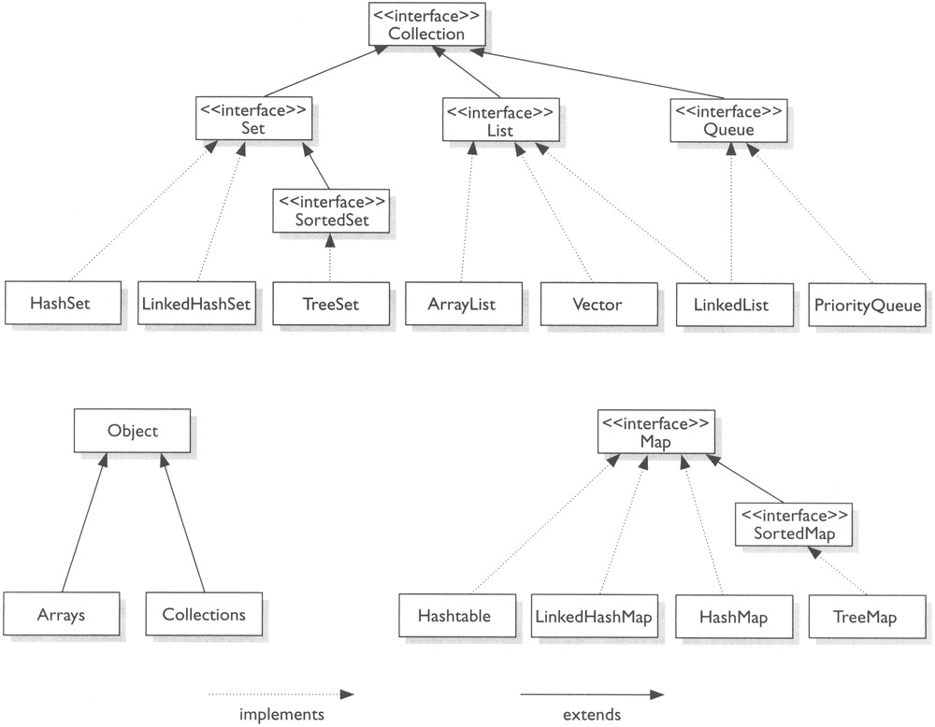
Java Collection Framework
List
ArrayList
LinkedList
Vector
Set
HashSet
LinkedHashSet
TreeSet
Map
HashMap
TreeMap
LinkedHashMap
Hashtable

Slide 4
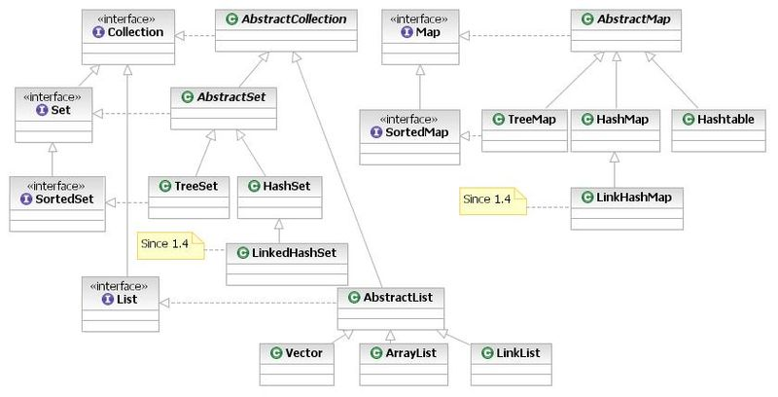
Java Collection Framework

Slide 5
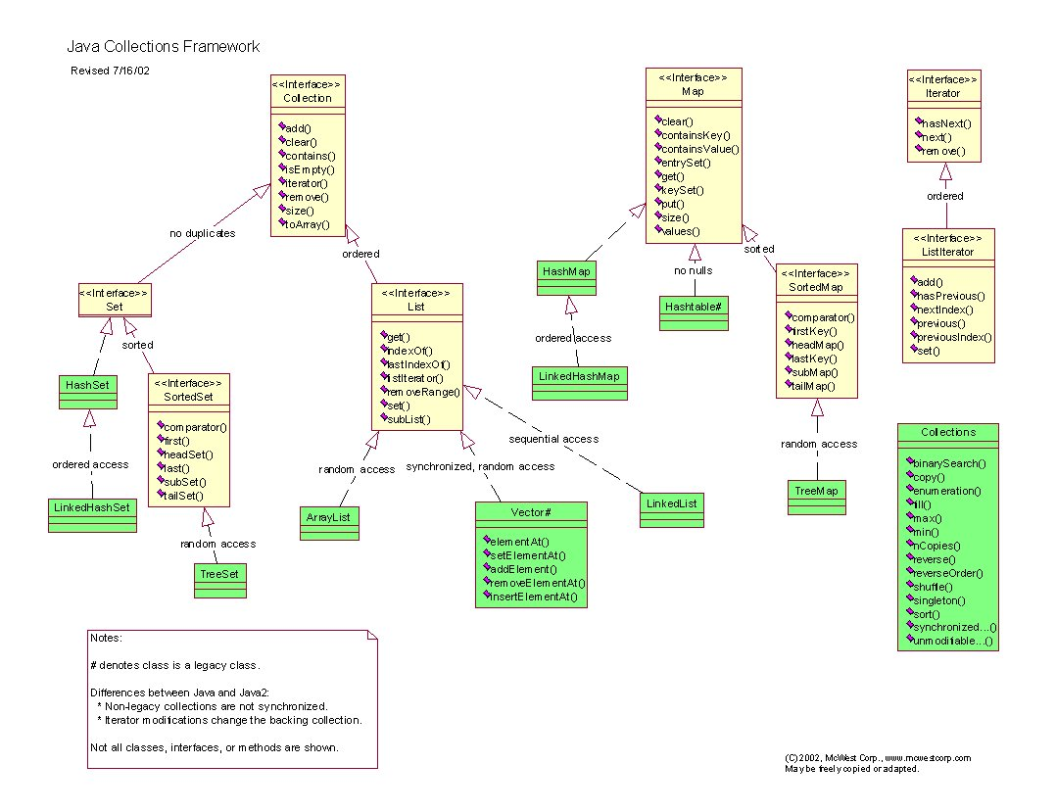

Slide 6
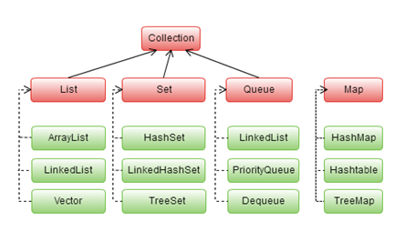
Collection Framework
Represent a group of objects (elements)
Mostly use through its “Interface”
Some allow duplicate elements
Eg: List (Set not allow)
Some are ordered
Eg: ArrayList
Some are null value

Slide 7
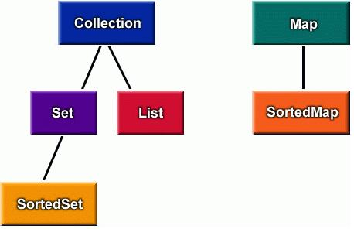
Collection Interface
Represent any group of objects
At the top of the collections hierarchy
Support basic operation
Adding & removing
Support query operators
int size()
boolean isEmpty()
boolean contains(Object o)
Iterator iterator()

Slide 8
Iterator Interface
Allow remove elements during iteration
Contain important methods:
hasNext() (boolean)
next() (Object)
remove() (void)
Can create from any its Concret class …
ArrayList, HashSet …
Collection<String> c = new TreeSet<String>();
c.add("A");
c.add("B");
c.add("C");
System.out.println(c.size());
for (Iterator<String> it = c.iterator(); it.hasNext();){
it.next();
it.remove();
}
System.out.println(c.size());
Will show 3
Will show 0

Slide 9
Set Interface
extends the Collection interface
Forbids duplicates
int count[] = { 10, 15, 10, 20, 30, 10 };
Set<Integer> set = new HashSet<Integer>()
for (int i = 0; i < 5; i++) {
set.add(count[i]);
}
System.out.println(set);
[10, 15, 10, 20, 30, 10]
[20, 10, 30, 15]

Slide 10
SortedSet Interface
extends Set
Sorted the elements
int count[] = { 10, 15, 10, 20, 30, 10 };
SortedSet<Integer> set = new TreeSet<Integer>()
for (int i = 0; i < 5; i++) {
set.add(count[i]);
}
System.out.println(set);
[10, 15, 20, 30]

Slide 11
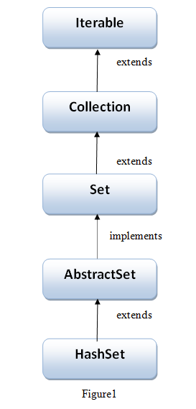
HashSet class Implementation
Elements in any random orders
Not allow duplicate items, and allow null value,
HashSet Is non-synchronized
Commons methods (add , clear , contains, isEmpty, size, remove, ...

Slide 12
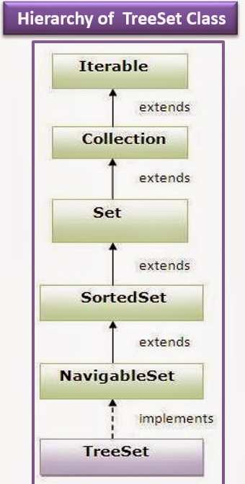
TreeSet class Implementation
Similar to HashSet
But it orders by ascending order
Performance slower than HashSet
Commons methods (add , clear , contains, isEmpty, size, remove, ...

Slide 13
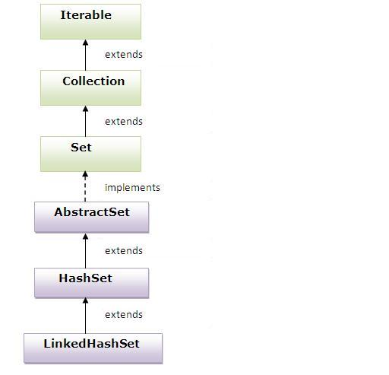
LinkedHashSet class Implementation
Similar to hashSet and TreeSet except
HashSet doesn’t maintain any kind of order of its elements.
TreeSet sorts the elements in ascending order.
LinkedHashSet maintains the insertion order. Elements gets sorted in the same sequence in which they have been added to the Set.
Commons methods (add , clear , contains, isEmpty, size, remove, ...

Slide 14
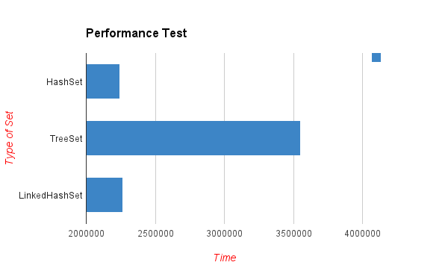
Performance

Slide 15
Lab
Basic operations add, contains , empty, iterator
Using HashSet, TreeSet and LinkedHashSet
ex : convert Array below into Set (HashSet, TreeSet and LinkedHashSet)
String[] languages = {“C”, “C++”, “JAVA”, “PHP”, “Python”, “GO”, “JAVA”, “ASP”}
Use basic operation methods add, remove, size,...empty(), contains …
Create a method displayAll(Set<String) using iterator or for loop
Using Arrays.asList...

Slide 16
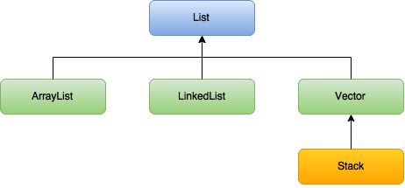
List Interface
extends Collection Interface
Ordered collection
Allow duplicate elements
Access element by its index
Elements can be inserted by the index position
Zero based-index

Slide 17
List Interface
add(int index, Object element)
add(Object o)
Appends the specified element to the end of this list
addAll(Collection c)
addAll(int index, Collection c)
clear()
contains(Object o) -> boolean
containsAll(Collection c)
get(int index)
isEmpty()

Slide 18
List Interface
int count[] = { 10, 15, 10, 20, 30, 10 };
List<Integer> list = new ArrayList<Integer>();
for (int i = 0; i < count.length; i++) {
list.add(count[i]);
}
System.out.println(list);
[10, 15, 10, 20, 30, 10]

Slide 19
ArrayList
Allow null value
Resizable-array implementation of the List interface
0 Based-index and accessing element by index
non-synchronized and can be made synchronized explicitly by using Collections.synchronizedList method.
Commons methods (add , clear , contains, isEmpty, size, remove, ...

Slide 20
ArrayList
List<String> list = new ArrayList<>();
//add elements to the ArrayList
list.add("JAVA");
list.add("C++");
list.add("PERL");
list.add("PHP");
System.out.println(list);
//get elements by index
System.out.println("Element at index 1: "+list.get(1));
System.out.println("Does list contains JAVA? "+list.contains("JAVA"));
//add elements at a specific index
list.add(2,"PLAY");
System.out.println(list);
//check Empty or not
System.out.println("Is arraylist empty? "+list.isEmpty());
//indexOf
System.out.println("Index of PERL is "+list.indexOf("PERL"));
//size
System.out.println("Size of the arraylist is: "+list.size());
Collections.reverse(list);
System.out.println("Results after reverse operation:");
System.out.println(list);

Slide 21
LinkedList
Allow null value
Base double linked list
non-synchronized and can be made synchronized explicitly by using Collections.synchronizedList method.
Commons methods (add , clear , contains, isEmpty, size, remove, ...

Slide 22
LinkedList
LinkedList<String> list = new LinkedList<String>();
list.add("Orange");
list.add("Apple");
list.add("Grape");
list.add("Banana");
System.out.println(list);
System.out.println("Size of the linked list: "+list.size());
System.out.println("Is LinkedList empty? "+list.isEmpty());
System.out.println("Does LinkedList contains 'Grape'? "+list.contains("Grape"));
- try using addFirst(obj), addLast(obj), getFirst(), getLast()

Slide 23
ArrayList vs LinkedList
ArrayList
LinkedList
Access by index faster O(1)
ArrayList internally uses dynamic array to store the elements
Allow duplicated items and null values
ArrayList is better for storing and accessing data ( get or search items)
Access by index slow O(n) – internal lookup by element
LinkedList internally uses doubly linked list to store the elements.
Allow duplicated items and null values
LinkedList is better for manipulating data (add or remove).

Slide 24
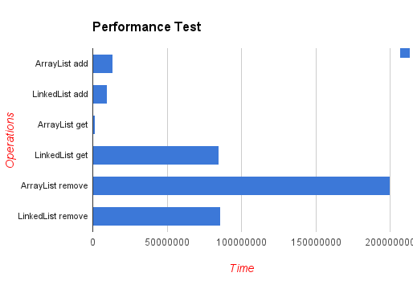
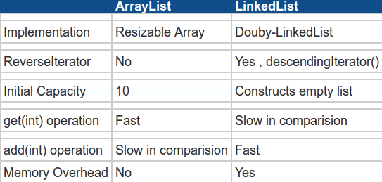
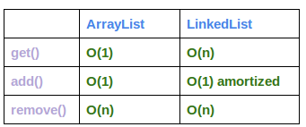
ArrayList vs LinkedList

Slide 25
When to use ArrayList andLinkedList
LinkedList is not as popular as ArrayList but still there are situation where a LinkedList is better choice than ArrayList
LinkedList should be preferred if
there are no large number of random access of element
there are a large number of add/remove operations
Use ArrayList in Java for all there situation where you need a non-synchronized index based access. ArrayList is fast and easy to use, just try to minimize array resizing by constructing arraylist with proper initial size.

Slide 26
List Vs Set Interface
List
Set
ArrayList, LinkedList as class implementation
Ordered collection - insertion order
Allow duplicated items and null values
has one legacy class implementation (Vector)
ListIterator can be used to traverse a List in both directions (forward and backward)
ArrayList, LinkedList as class implementation
Ordered collection - insertion order
Allow duplicated items and null values
Can use only Iterator to traverse a Set

Slide 27
When to use List or Set
The usage is purely depends on the requirement
If the requirement is to have only unique values then Set is your best bet as any implementation of Set maintains unique values only.
If there is a need to maintain the insertion order irrespective of the duplicity then List is a best option. Both the implementations of List interface – ArrayList and LinkedList sorts the elements in their insertion order.

Slide 28
Lab
Basic operations add, contains , empty, iterator
Using ArrayList, LinkedList
ex : convert Array below into List
String[] languages = {“C”, “C++”, “JAVA”, “PHP”, “Python”, “GO”, “JAVA”, “ASP”}
Use basic operation methods get add, remove, size,...empty(), contains …
Create a method displayAll(List<String) using iterator or for loop
Using Arrays.asList...

Slide 29
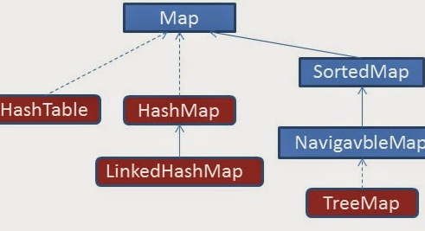
Map Interface
Not extends from Collection
Maintaining key-value associations
Order or not depend on concrete class
Mapping from key to values
Without duplicate keys

Slide 30
Map Interface
void clear
boolean containKey(Object key)
boolean containValue(Object value)
Object get(Object key)
boolean isEmpty()
Set keySet()
Object put(Object key, Object v)
The previous value linked to the key is return
void putAll(Map m)

Slide 31
Map Interface
int count[] = { 10, 15, 10, 20, 30, 10 };
Map<String, Integer> m = new HashMap<String, Integer>();
for (int i = 0; i < count.length; i++) {
m.put(String.valueOf(i), count[i]);
}
System.out.println(m);
{3=20, 2=10, 1=15, 0=10, 5=10, 4=30}

Slide 32
TreeMap, HashMap & Hashtable
TreeMap
Sorted
Slow performance
Not synchronized
Use key to access
Support null key & null value

Slide 33
TreeMap
/* This is how to declare TreeMap */
TreeMap<Integer, String> tmap =
new TreeMap<Integer, String>();
/*Adding elements to TreeMap*/
tmap.put(1, "Data1");
tmap.put(23, "Data2");
tmap.put(70, "Data3");
tmap.put(4, "Data4");
tmap.put(2, "Data5");
/* Display content using Iterator*/
Set set = tmap.entrySet();
Iterator iterator = set.iterator();
while(iterator.hasNext()) {
Map.Entry mentry = (Map.Entry)iterator.next();
System.out.print("key is: "+ mentry.getKey() + " & Value is: ");
System.out.println(mentry.getValue());
}

Slide 34
HashMap
Key and value based
Allows null key and multiple null values.
no order key and value.
Not synchronized
Performance better than TreeMap

Slide 35
HashMap
Map<Integer, String> mapHttpErrors = new HashMap<>();
mapHttpErrors.put(303, "See Other");
mapHttpErrors.put(200, "OK");
mapHttpErrors.put(404, "Not Found");
mapHttpErrors.put(500, "Internal Server Error");
System.out.println(mapHttpErrors);
//get
String status301 = mapHttpErrors.get(301);
System.out.println("301: " + status301);
//Checking if the map contains a specified key:
if (mapHttpErrors.containsKey("200")) {
System.out.println("Http status 200");
}
//size , isEmpty , remove and scan all elements for loop Map.Entry , map.entrySet

Slide 36
Hashtable
Not support null key & null value
Use key to access
Synchronized
Implemented from Dictionary

Slide 37
Hashtable
Hashtable<String, Double> balance = new Hashtable<>();
balance.put("Zara", new Double(3434.34));
balance.put("Mahnaz", new Double(123.22));
balance.put("Ayan", new Double(1378.00));
balance.put("Daisy", new Double(99.22));
balance.put("Qadir", new Double(-19.08));
for (Entry<String, Double> item : balance.entrySet()) {
System.out.println("key : " + item.getKey() + ", value =" + item.getValue());
}

Slide 38
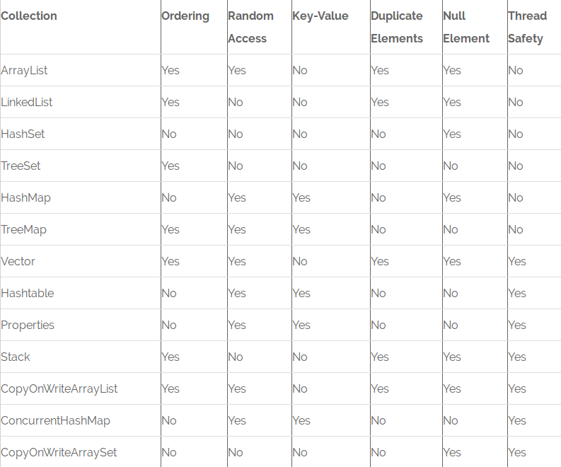
Collection summary

Slide 39
References :
http://beginnersbook.com/java-collections-tutorials/
http://www.journaldev.com/1260/collections-in-java-tutorial#java-collections-overview
http://www.codejava.net/java-core/collections/java-list-collection-tutorial-and-examples

Slide 40
Exercise
1 – read more : https://github.com/sophea/java-programming/blob/master/exercise_java_collection.txt
2- we have list name of countries , convert all list into map by grouping key as first letter of country with value of list of countries with the same first letter. For instance : Country names Australia, Afghanistan , it will be stored in map key "A" , values ["Australia","Afghanistan"]
Source code to get all countries as List<String> : https://github.com/sophea/java-programming/blob/master/src/main/java/basic/collection/CountriesList.java
Read more
3 - read more Collection with methods equals() and hashCode() in Java - http://www.codejava.net/java-core/collections/understanding-equals-and-hashcode-in-java
4- read more : Understanding Object Ordering in Java with Comparable and Comparator : http://www.codejava.net/java-core/collections/understanding-object-ordering-in-java-with-comparable-and-comparator
5 - research Java 8 features : Collections with Stream (http://www.journaldev.com/2774/java-8-stream#stream-collections )

